Slide 1
Analysis on 2019 Iowa Alcohol Sales
By: Dedrick

Slide 2
Problem Overview
Bob would like to open a alcohol store in Iowa state.
Situation
What insights can help Bob in his decision ?
Question
Insight
Location
Items
Categories
Vendor

Slide 3
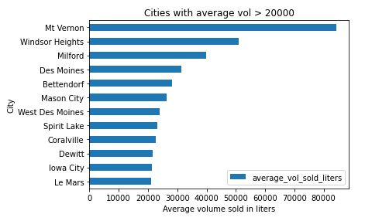
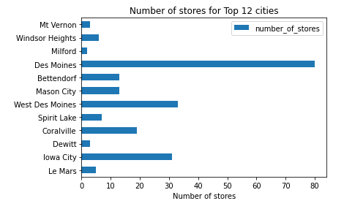
Location
Mt Vernon, Windsor Heights and Milford are suitable due to lesser competition

Slide 4
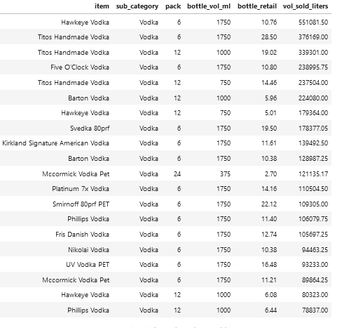
Items: Vodka
Vodka
All Hawkeye Vodka
All Titos Handmade Vodka
Five O’Clock Vodka

Slide 5
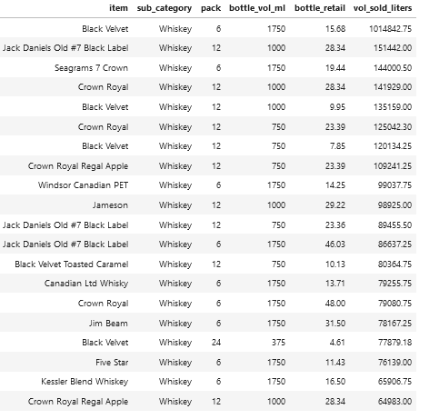
Items: Whiskey
Whiskey
All Black Velvet
Jack Daniel Black Label 1L
Crown Royal 1L
Crown Royal 0.75L
Crown Royal Regal Apple 0.75L
Jameson

Slide 6
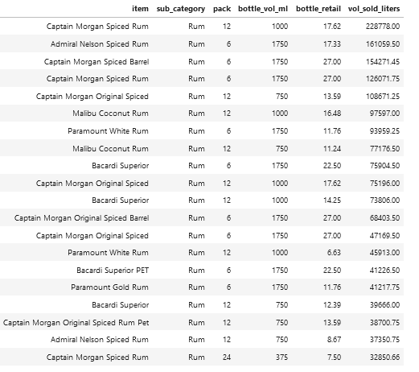
Items: Rum
Rum
Captain Morgan Spiced Rum
Captain Morgan Spiced Barrel
Captain Morgan Original Spiced
Malibu Coconut Rum

Slide 7
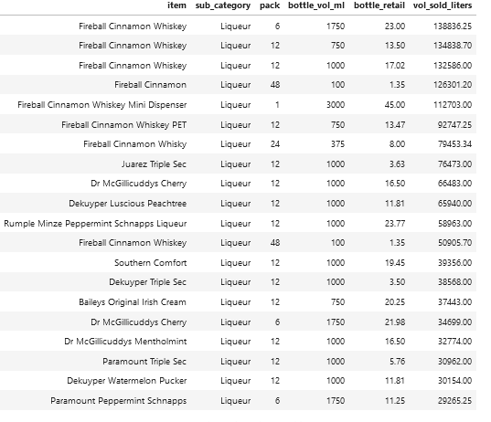
Items: Liqueur
Liqueur
All Fireball Whiskey

Slide 8
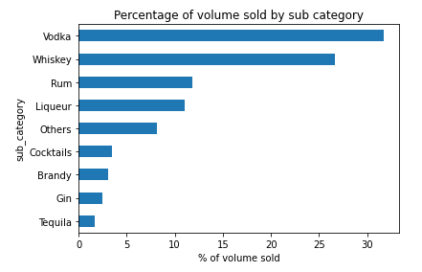
Categories
Categories
30%: Vodka
30%: Whiskey
10%: Rum
10%: Liqueur
20% Everything else

Slide 9
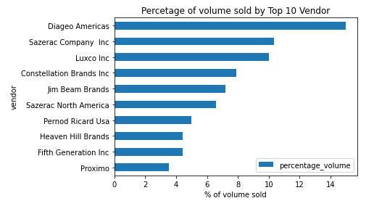
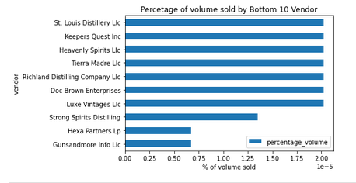
Vendor
Vendors that are more well known sell more than less popular brands

